Slide 1

Department of Computer Science & Engineering Smart Segregation System Batch no. 11 1. 2411CS010462(P.Venu Kumar) 2. 2411CS010533(T.Manipal Reddy) 3. 2411CS010625 (B.Shravani Reddy) 4. 2411CS010322(M.Srishanth) Guide Mrs.Gandu Lavanya
Maisammaguda, Kompally, Medchal - Malkajgiri District Hyderabad - 500100, Telangana State. www.mallareddyuniversity.
(Telangana State Private Universities Act No. 13 of 2020 &
G.O.Ms. No. 14, Higher Education (UE) Department)

Slide 2
Table of Contents
Introduction
Abstract
Literature Survey
Limitations of Existing Algorithms/Methodologies
Flowchart
Architecture
Screenshots Of Application
Hardware/Software Requirements
Conclusion

Slide 3
Introduction
An AI Smart Segregation System is an intelligent system that uses Artificial Intelligence (AI) and modern technologies to automatically separate different types of waste or materials. The main purpose of this system is to improve waste management by identifying and sorting items such as plastic, metal, paper, glass, and organic waste without human effort.Traditional waste segregation is usually done manually, which can be time-consuming, inefficient, and sometimes unsafe. With the help of AI technologies like machine learning, sensors, and image recognition, the smart segregation system can detect the type of material and place it in the correct category automatically.The system typically uses cameras, sensors, and automated mechanisms to analyze the waste. Once the material is recognized, the system directs it to the appropriate bin or container. This helps in reducing environmental pollution, improving recycling efficiency, and saving time and labor.

Slide 4
Abstract
The AI Smart Segregation System is an intelligent solution designed to automatically separate different types of waste using artificial intelligence and machine learning techniques. Waste management is a major environmental challenge, and manual segregation is time-consuming, inefficient, and prone to human error. This system aims to improve the efficiency and accuracy of waste sorting by using image processing and AI algorithms.In this system, a camera captures images of waste items placed on a conveyor or input area. The captured images are processed using a trained machine learning or deep learning model that identifies the type of waste such as plastic, metal, paper, glass, or organic waste. Based on the classification result, the system automatically directs the waste to the appropriate bin using actuators or mechanical mechanisms.
The proposed system helps in reducing human effort, improving recycling efficiency, and promoting proper waste management practices. I

Slide 5
Literature Survey
Title: Smart Segregation System
Description: Recent studies highlight the growing importance of smart waste segregation systems due to rapid urbanization and increasing waste generation. A study on IoT-based waste segregation systems explains that traditional waste handling leads to unhygienic conditions and health risks, and proposes automated segregation using sensors to reduce human effort and improve efficiency . Another research work on smart waste detection systems uses components like infrared sensors, inductive sensors, and microcontrollers to classify waste into different categories, showing that automation can significantly enhance accuracy and reduce manual errors.

Slide 6
Limitations of Existing Algorithms/Methodologies
Existing algorithms and methodologies for smart segregation systems face significant limitations across all five functional areas, hindering their effectiveness. For dashboards and analytics, the primary issues are data latency and architectural silos, where disparate systems fail to integrate seamlessly, resulting in delayed insights and a lack of predictive or prescriptive capabilities necessary for proactive decision-making. In waste monitoring and bin management, the limitations are largely hardware-dependent and logistical; sensor reliability is compromised by environmental factors and connectivity issues, while route optimization algorithms remain largely static, failing to adapt dynamically to real-time fill levels or predict maintenance needs. Finally, AI training is constrained by data scarcity and bias, as models trained on limited datasets struggle to generalize across diverse waste streams and lighting conditions, with concept drift and high annotation costs further degrading long-term accuracy and trust in the system.

Slide 7
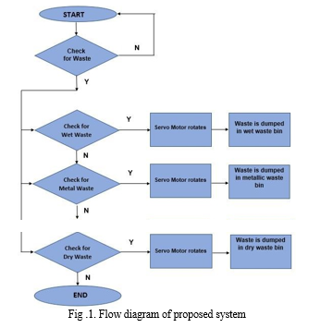
Flowchart

Slide 8
Architecture

Slide 9

Screenshots
Sign In Page

Slide 10
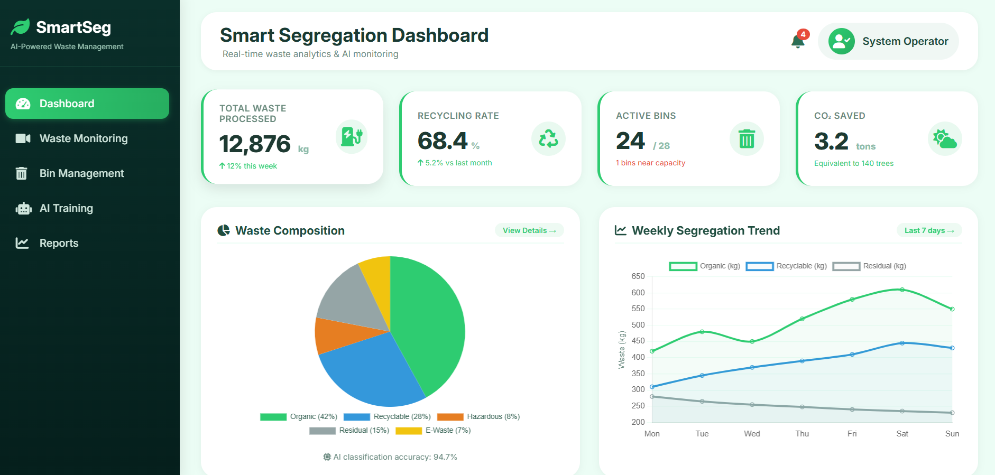
Screenshots
Admin Dashboard

Slide 11
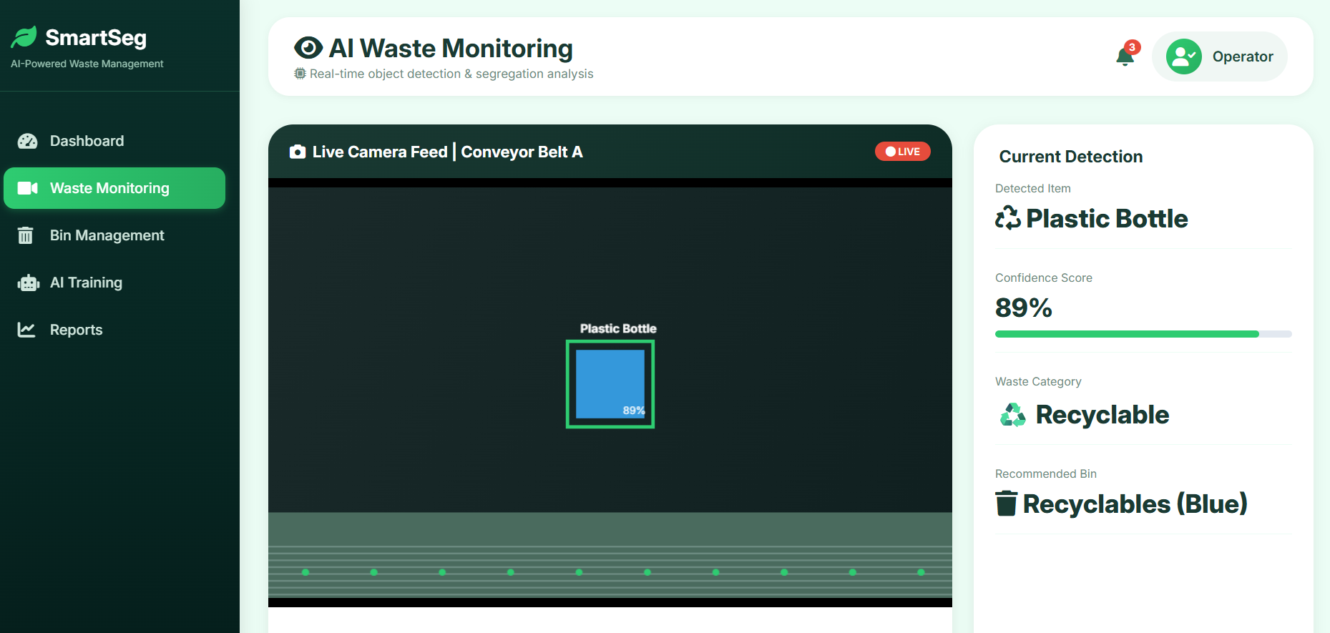
Screenshots

Slide 12
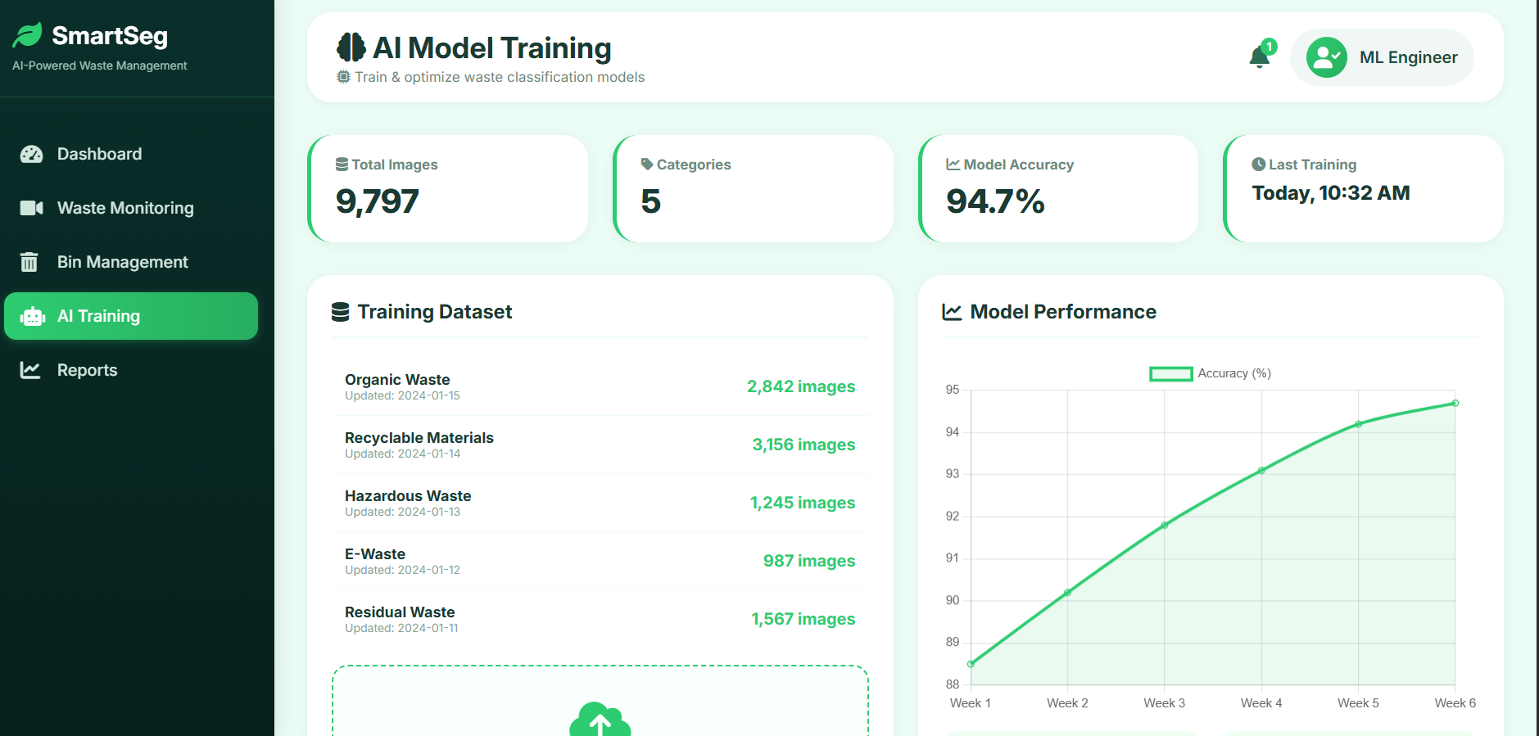
Screenshots
AI Model Training

Slide 13
Hardware/Software Requirements
Hardware Requirements:
Processor: Intel i3 / AMD Ryzen 3 or above
RAM: Minimum 4 GB (8 GB recommended)
Storage: At least 50 GB free disk space

Slide 14
Hardware/Software Requirements
Software Requirements:
Operating System: Windows , Linux, or macOS
Programming Language: Python
Frameworks: Django
Database: MySQL
Machine Learning Libraries: Scikit-learn, TensorFlow, or Pandas
Frontend Technologies: HTML, CSS, JavaScript

Slide 15
Conclusion
The AI Smart Segregation System provides an efficient and intelligent
solution for modern waste management problems. By using Artificial
Intelligence, image processing, sensors, and automated mechanisms, the
system can identify and separate different types of waste such as plastic,
metal, paper, and organic materials automatically. This reduces the need for
manual sorting and improves the overall efficiency of the waste management
process.The system helps in reducing environmental pollution, increasing
recycling rates, and promoting proper waste disposal practices. Automation
also saves time, minimizes human effort, and reduces health risks for workers
who would otherwise handle waste manually. Although there are some
challenges such as implementation cost, accuracy under different conditions,
and hardware

Slide 16
THANK YOU

